Slide 1
Defining and classifying groups
Group
A group is defined as two or more individuals, interacting and interdependent, who have come together to achieve particular objectives.

Slide 2
Groups can be formal or informal.
FORMAL GROUPS
The groups which are defined by organization’s structure, with designated work assignments and tasks.

Slide 3
INFORMAL GROUPS
The alliances that are neither formally structured nor organizationally structured.
FOR EXAMPLE;
Three employees from different departments who regularly eat lunch or coffee together.

Slide 4
Classification of groups
Further sub classification of groups as;
Command groups
Task groups
Interest groups
Friendship groups

Slide 5
COMMAND GROUP
A group composed of the individuals who directly report to the given manager.
Like; elementary school principal and her teachers.

Slide 6
TASK GROUPS
People working together to complete a job task.
Like; college accused of a campus crime.

Slide 7
INTEREST GROUPS
People working together to attain a specific objective with each is concerned.

Slide 8
FRIENDSHIP GROUPS
Groups often develop because the individual members have one or more common characteristics. Like; social alliances.

Slide 9
WHY DO PEOPLE JOIN GROUPS ?
By joining the group following are the factors :-
Security
Status
Self Esteem
Affiliation
Power
Goal Achievement.

Slide 10
Security:
By joining the groups, individuals can reduce the insecurity of standing alone. People can feel stronger, have fewer self doubts.

Slide 11
Status:
In a group, that is view as important to provides recognition and status for its members.

Slide 12
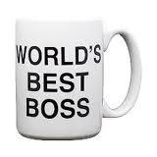
Self-Esteem: Groups can provide people with feeling of self worth. In addition to conveying status to those outsides the group.

Slide 13
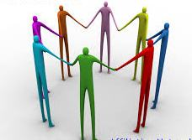
Affiliation (Relationship): Groups can fulfill the social needs. People enjoy the interaction that comes with groups. On-the-Job interactions, its fulfill the need for affiliation.

Slide 14
Power: What cannot be achieve individually often becomes possible through group action. There is the power in numbers.

Slide 15
Goal Achievement: There are times when it takes more than one person to accomplish a particular task—there is a need to pool talents, knowledge and power in order to complete a job.

Slide 16
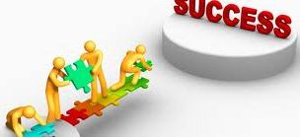
WHAT ARE THE EXTERNAL CONDITION IMPOSE ON THE GROUP?
1.Organization strategies:
How to improve the structure?
Quality increase.
Minimize the cost.
Profitability increase.

Slide 17
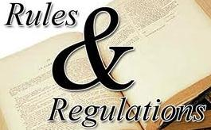
2.Authority Structure: .
who report to whom, direct report or level vise reporting.
3.Formal Rules:
What are the rules and regulation?
Job description.

Slide 18
4.Resources:
In Resources, money is required to popup the problems with large and small resources.
5.Employees Selection Process
What are the characteristics of an employee to require or join a group.

Slide 19
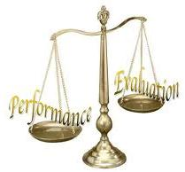
6.Performance Evaluation:
Check the performance evaluation:
Individually
Group vise.
7.Reward System:
To encourage the employee by providing the reward system.

Slide 20
8.Culture:
In groups, people are differ with each other due to the culture differences.
9.Physical Work Setting:
Based on the group environment to achieve the goals.

Slide 21
Positive Work Environment

Slide 22
Stages of Group Development

Slide 23
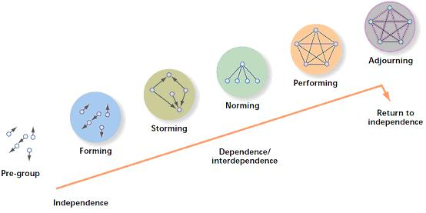
5 Stages Of Group Development
The five distinct stages groups go through :
1: Forming
2: Storming
3: Norming
4: Performing
5: Adjourning

Slide 24
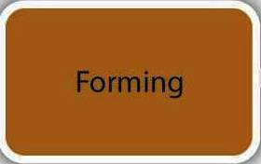
1: Forming Stage
It is characterized by a great deal of uncertainty about the group’s purpose, structure, responsibilities, leadership and objectives.

Slide 25
2: Storming Stage
It is characterized by intrgroup conflict.
There is conflict over who will control the group.
Team members open up with each other and confront each other’s ideas and perspectives.
But, when this stage is complete, there will be clear hierarchy of leadership within the group.

Slide 26
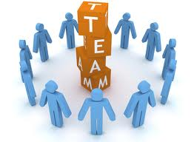
3: Norming Stage
Close relationships develop and the group demonstrates Cohesiveness.
Bench and standards are set to and members try to achieve those standards.
Enthusiasm is high.
Accept ground roles, rules, and individuality of fellow members.

Slide 27
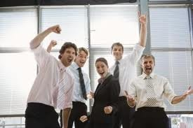
4: Performing Stage
At this stage, we have to maximize our performance. At this point, the structure is fully functional and accepted. Group members start getting to know and understand each other to performing the task. Begin performing by diagnosing, problem solving and implementing changes.

Slide 28
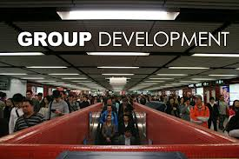
5: Adjourning Stage
The final stage of group development for temporary groups, characterized by concern with wrapping up activities rather than task performance.

Slide 29
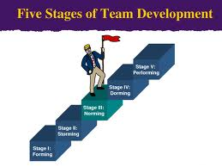
Weaknesses of 5 Stages Model
Many interprets of the 5 stages model have assumed a group becomes more effective through the first 4 stages.
High levels of conflict may be conductive to high group performance.
Sometimes we achieve group effectiveness at the II or III stage but sometimes after reach the IV stage we cannot achieve or increase the group effectiveness.
Therefore, even strongest proponents of this model do not assume all groups follow its 5 stage process or we can’t say that stage 4 is always preferable.

Slide 30
Group Properties
Group Properties are those factors which ensure that a group is capable and skilled enough to accomplish the task assigned.

Slide 31
Group Properties
Some of the basic group properties are
Roles
Norms
Status
Group size
Group cohesiveness

Slide 32
Roles
Shakespeare said
“All the world is a stage, and all the men and women merely players”

Slide 33
Roles
Role means the expected behavior pattern attributed to someone occupying a given position in a social unit.
In our society, each individual is assigned more than one role which requires more than one behavior and causes Role Diversity.

Slide 34
Components of Roles
Group Role can be understood in four way which are
Role Identity
Role perception
Role expectation
Role conflict

Slide 35
Role Identity
Certain attitudes and actual behavior are consists with a role and they create the role identity.
People have the ability to shift roles rapidly when they recognize that a situation and it’s demand clearly required major changes.

Slide 36
Role perception
Role perception refers to our view of how we are supposed to react in a given situation.
We adapt certain type of behaviors depending on our believe that how should we response.

Slide 37
Role expectation
This component refers to the expectation of people around us, from us.
In other words it signifies the expectation that people have from us to react in a certain way.

Slide 38
Role Conflict
When more than one role is assigned to an individual, it demands different responses according to each role, this creates the problem of role conflict.

Slide 39
Properties 2 and 3
Norms
Status

Slide 40
Norms
Definition
“ Acceptable standard of behavior that are shared by the group members”

Slide 41
Norms
It guides to the members of group
Means of influencing the group behavior
It vary from, culture to culture
Different groups, communities and societies have different norms

Slide 42
Types of Norms
Performance norms
Appearance norms
Social arrangement norms
Resource allocation norms

Slide 43
Status
Definition
“A socially defined position or rank given to groups or group members by others”

Slide 44
Status
It differentiate its members
To understand human behavior

Slide 45
What Determines Status ?
Power a person wields over others
Person’s ability to contribute to groups’ goals
An individual personal
characteristics

